Slide 1





Stock Price Prediction using Machine Learning
Team : 1)ISHWAREE PATIL (ishupatil2003@gmail.com)
2) SHREYA RAJOBA (shreyarajoba@gmail.com)
3)SAKSHI ADMUTHE (sakshiadmuthe13@gmail.com)
Guide : Vignesh sir
Disclaimer: The content is curated for educational purposes only.
Notes:
Slides: Prepare a short slide deck (10-12 slides) summarizing the project objectives, methodology, and key results.

Slide 2
OUTLINE
Abstract of the Project
Problem Statement
Proposed Solution
System Architecture
Live Demo of the Project
Embedded Video of Project
Conclusion
Future Scope

Slide 3
Abstract
Stock price prediction is crucial for investors to minimize risks and maximize returns
Machine learning models like Linear Regression, Random Forest, and LSTM help in forecasting future stock prices.
Historical stock data, technical indicators, and market trends are analyzed to improve accuracy.
The project aims to build an intelligent stock price prediction system using data-driven insights.
Helps traders and investors in making informed and strategic decisions.

Slide 4
Problem Statement
Stock market fluctuations make it difficult to predict prices accurately.

Slide 5
Proposed Solution
Step 1: Data Collection – Gather historical stock price data from APIs (Yahoo Finance, Alpha Vantage).
Step 2: Data Preprocessing – Handle missing values, remove outliers, normalize data for better training.
Step 3: Feature Engineering – Extract key indicators like moving averages, RSI, MACD
Bollinger Bands.
Step 4: Model Selection – Train models such as:
Linear Regression – For basic trend analysis.
Random Forest – To handle complex patterns.
LSTM (Long Short-Term Memory) – For time-series forecasting.
Step 5: Model Evaluation – Measure accuracy using RMSE, R-Squared, MAPE.
Step 6: Deployment – Convert into an interactive web-based prediction tool.

Slide 6
System Architecture
2) Data Preprocessing:
Clean data, handle missing values, normalize data
3)Feature Engineering:
Compute moving averages, trading volume trends, volatility indicators.
1) Data Collection:
Fetch stock price data from APIs.
6) Visualization:
Plot stock price trends using Matplotlib/Pyplot
5)Prediction & Evaluation:
Compare actual vs. predicted stock prices.
4) Model Training:
Train models (Linear Regression, Random Forest, LSTM).
7) Deployment:
Develop a user-friendly web app/dashboard using Flask/Streamlit.

Slide 7
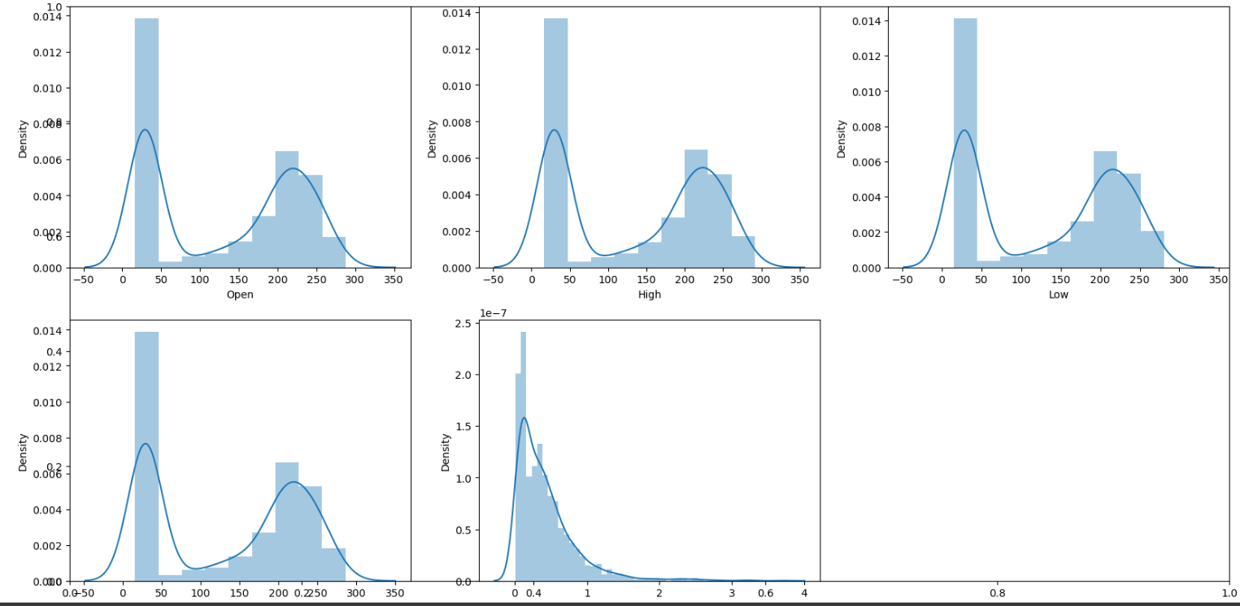
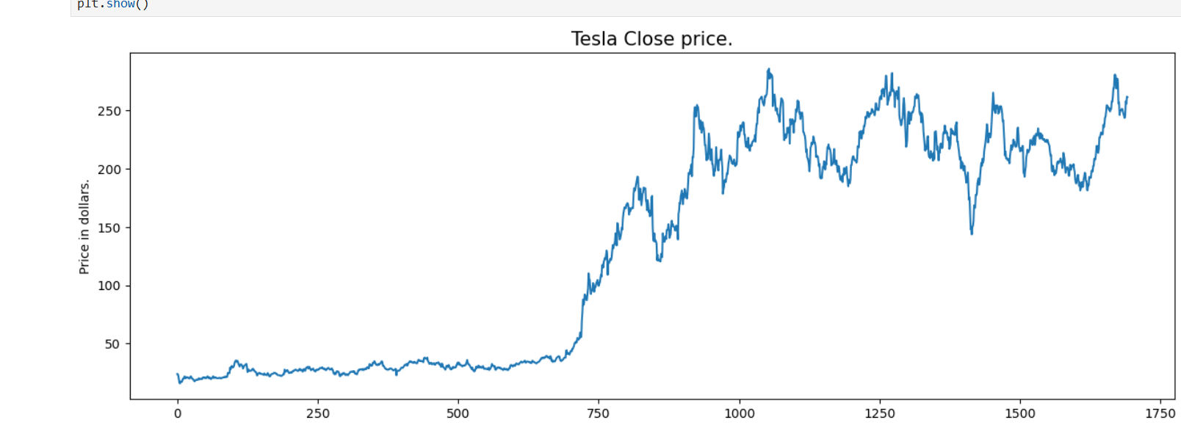
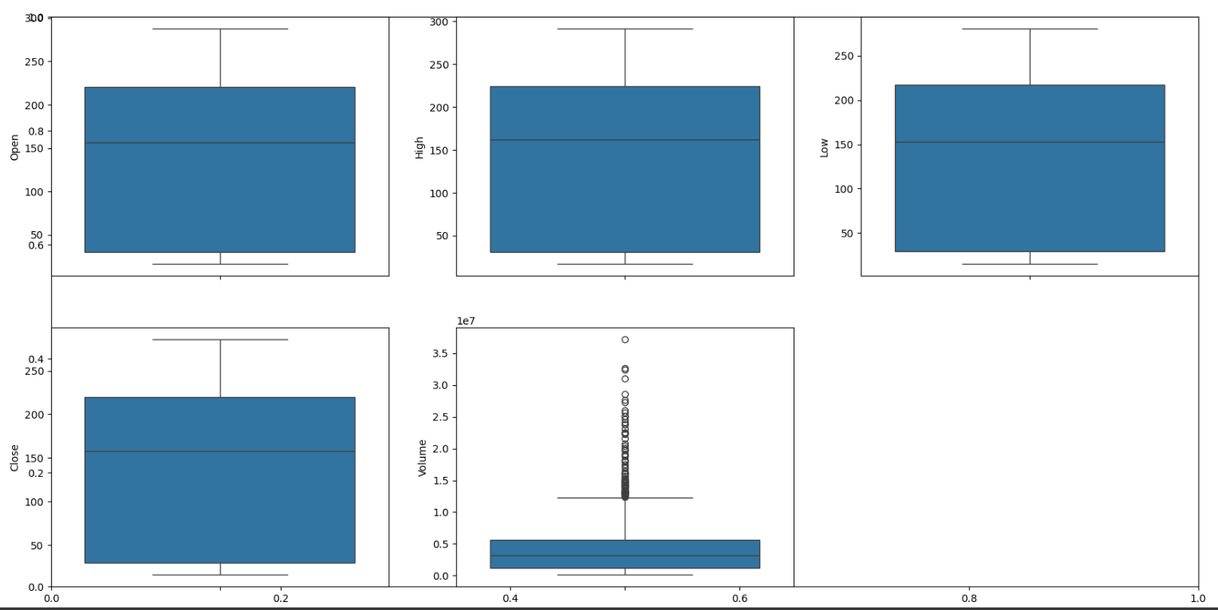
Live Demo of Project
Plots
Subplots
Box plot

Slide 8
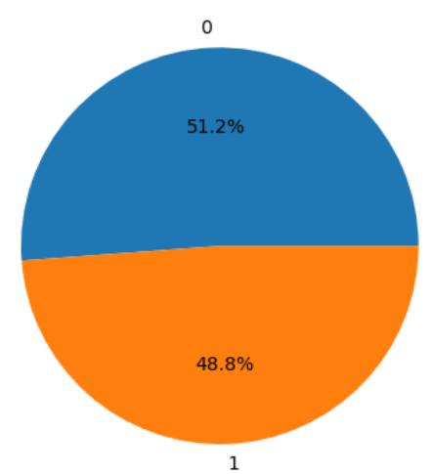
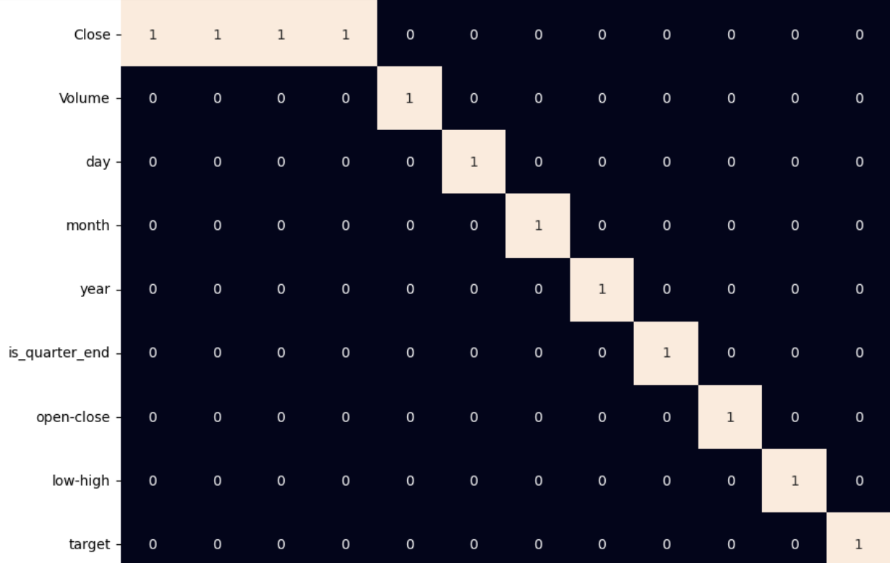
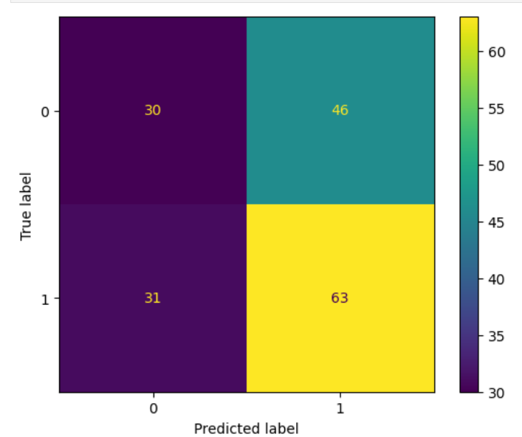
Project_Demo:
GithubLink: https://github.com/ishupatil/TECHSAKSHAM/tree/main/DATA%20ANALYSIS%20USING%20LIBRARIES
https://github.com/shreyarajoba28/tnp_project
https://github.com/sakshiadmuthe13/techsaksham_project/upload
Heat map for stock analysis on monthly to yearly basis
PIE CHART of stock analysis
Confusion matrix analysis for stocks

Slide 9
Conclusion
The model successfully predicts stock prices with improved accuracy.
Reduces investment risks by providing a data-driven approach.
Helps traders and investors make smarter decisions using AI-powered insights.
It Can be further enhanced with advanced techniques like deep learning and external data sources.

Slide 10
Future Scope
We Can Enhance accuracy by using Transformer models (e.g., BERT for stock market data)
In Integration with sentiment analysis from financial news, Twitter, Reddit to predict market trends.
We can Use reinforcement learning for stock trading strategy optimization. i.e Exploration and Exploitation
Expanding dataset by incorporating macroeconomic indicators (GDP, interest rates, inflation).
Deploying as a mobile app for real-time stock market insights.Developing an AI-powered chatbot for automated investment suggestions.

Slide 11
Thank you!
Notes:
thank you very much for joining this PPT, keep learning.
11

